Slide 1
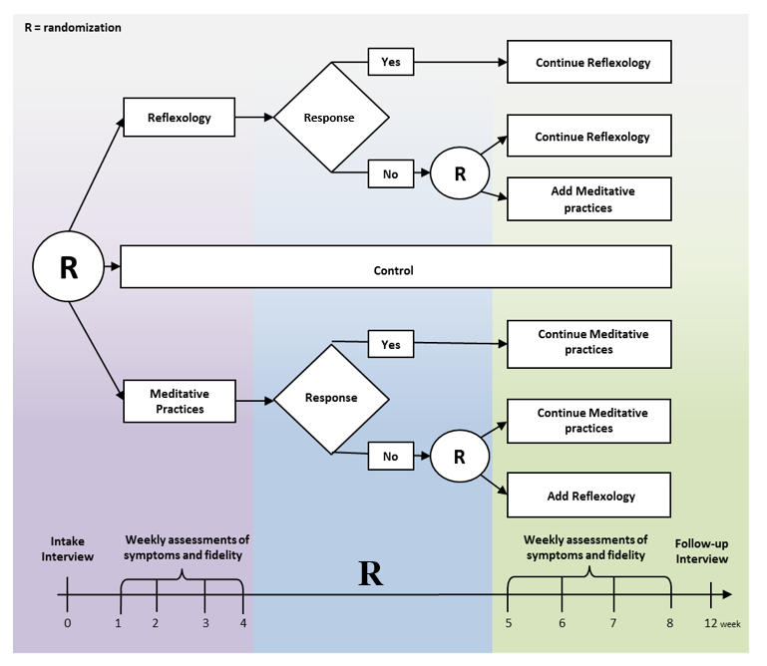
Tailored Psychological and Physical Symptom Management: Sequencing of Evidence-based Complementary Therapies
MPIs: Gwen Wyatt, RN, PhD, FAAN, FAPOS¹ and Alla Sikorskii, PhD, FAPOS⁴
Rebecca Lehto, RN, PhD, FAAN¹; Pratim Guha Niyogi, PhD (c)²; Sarah Brewer, MPH, PhD (c)³; David Victorson, PhD⁵; Thaddeus Pace, PhD⁶; Terry Badger, PhD, RN, PMHCNS-BC, FAPOS, FAAN⁶; Michigan State University College of Nursing;1 Department of Statistics and Probability;2 Department of Epidemiology and Biostatistics;3 Department of Psychiatry,4 East Lansing, Michigan, U.S.A; Northwestern University of Feinberg School of Medicine,5 Evanston, Illinois, U.S.A; University of Arizona College of Nursing,6 Tucson, Arizona, U.S.A
Background
Methods
Tailoring of symptom management interventions can meet individual needs. A 12-week sequential multiple assignment randomized trial (SMART) of reflexology and meditative practices delivered by, or practiced with, an informal caregiver at home. 471 patients undergoing treatment for solid tumor cancers were enrolled with their caregivers.
Patient-caregiver dyads were first randomized to reflexology, meditative practices, or control
Symptoms were evaluated weekly via phone, using the M.D. Anderson Symptom Inventory (MDASI)
If no response on fatigue from patient after 4 weeks, the dyad was re-randomized to add the other therapy or continue with the same one
4 decision rules were compared: reflexology for 8 weeks, reflexology for first 4 weeks then adding meditation, meditation for 8 weeks, and meditation for 4 weeks then adding reflexology for next 4
Results
No differences among the 4 decision rules at week 8, week 12, or average over weeks 5-12, exception of lower severity for summed MDSAI symptoms at week 8 for rule 1 versus rule 2 (p=.04).
The response rates after the initial 4 weeks were 45% in the reflexology group and 46% in the meditative practices group.
Conclusion
Purpose
Either reflexology or meditative practices can be used as an option for symptom management. Adding the other therapy for non-responders may not be warranted.
The purpose of this research was to establish sequencing of tested therapies based on decision rules for tailoring to patient needs.
This study was funded by the National Cancer Institute (1 R01 CA193706)

