Slide 1
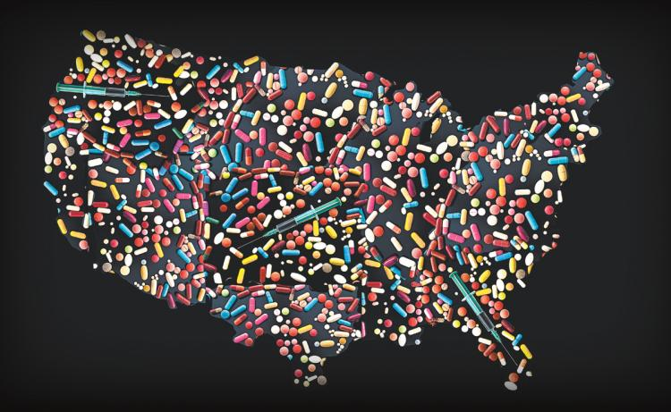
Changing the Narrative: Background and Current Reality
Capital Area Pain Conference, February 4, 2020
Linda S. Vail, Health Officer

Slide 2
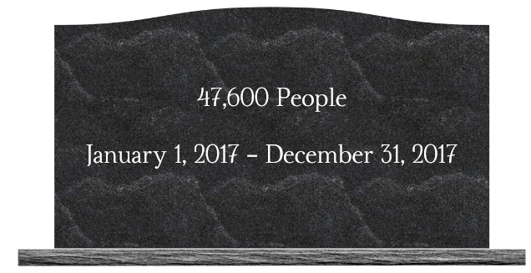

Slide 3
Let’s Put That in Perspective
Opioid related
Total

Slide 5
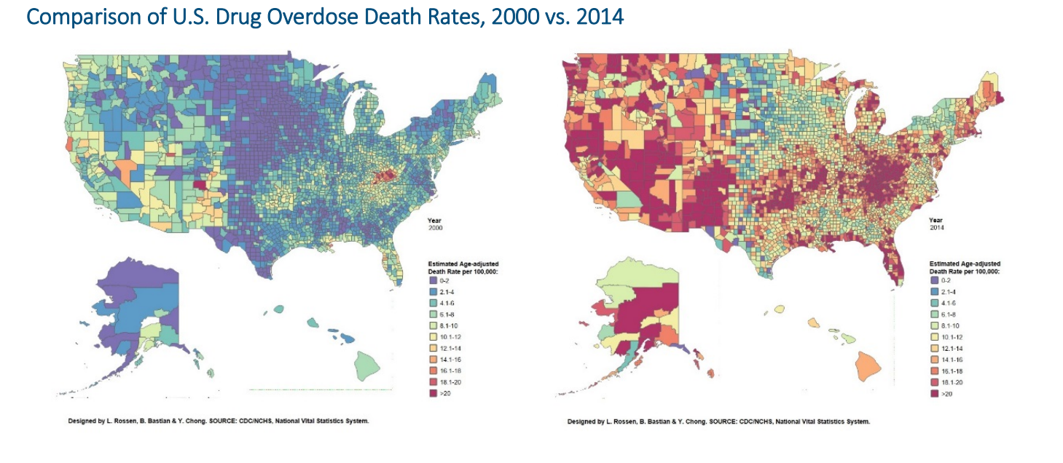

Slide 6
PHARMACEUTICAL COMPANIES
PHYSICIAN PRESCRIBING HABITS
THE AMERICAN PEOPLE

Slide 7
Pharmaceutical Companies

Slide 8
Between 1999 and 2010, sales of these “opioid analgesics”—medications like Vicodin, Percocet, and OxyContin—quadrupled.

Slide 9
A “New Era” of Opioids?

Slide 10
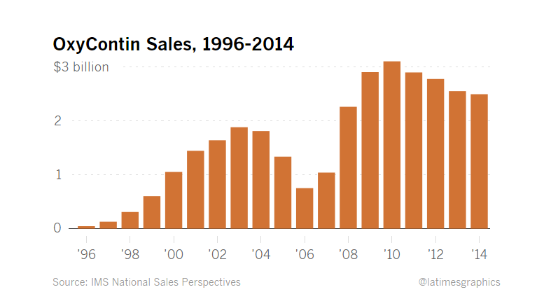

Slide 11
In 2007, Purdue Pharma and three of its top executives pleaded guilty to criminal charges that they had misled the F.D.A., clinicians, and patients about the risks of OxyContin addiction and abuse by aggressively marketing the drug to providers and patients as a safe alternative to short-acting narcotics. (Doctors had been taught that because OxyContin was time-released, it wouldn’t cause a high that would lead to addiction.)

Slide 12
Physician Prescribing habits

Slide 13
Pain: The 5th Vital Sign

Slide 14
The American People & The American way

Slide 17
By 2010, the United States, with about 5% of the world’s population, was consuming 99% of the world’s hydrocodone (the narcotic in Vicodin), along with 80% of the oxycodone (in Percocet and OxyContin), and 65% of the hydromorphone (in Dilaudid).

Slide 18
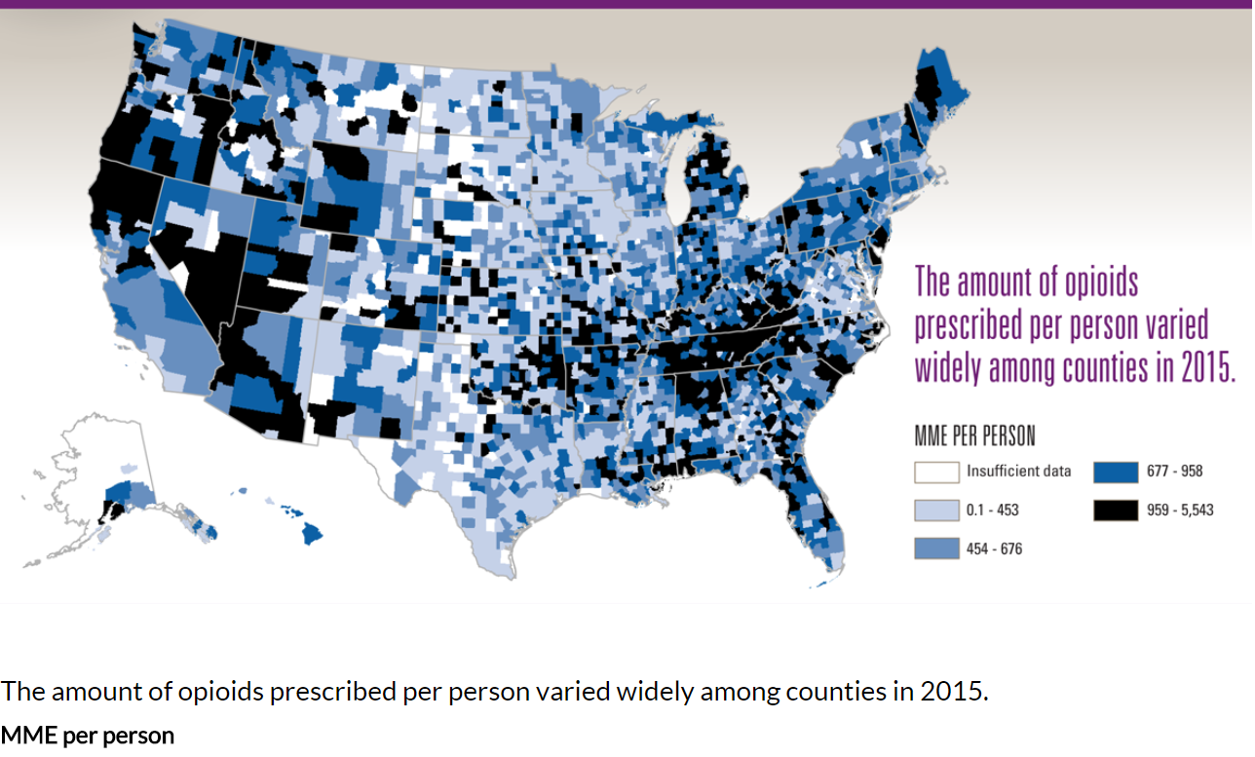

Slide 19
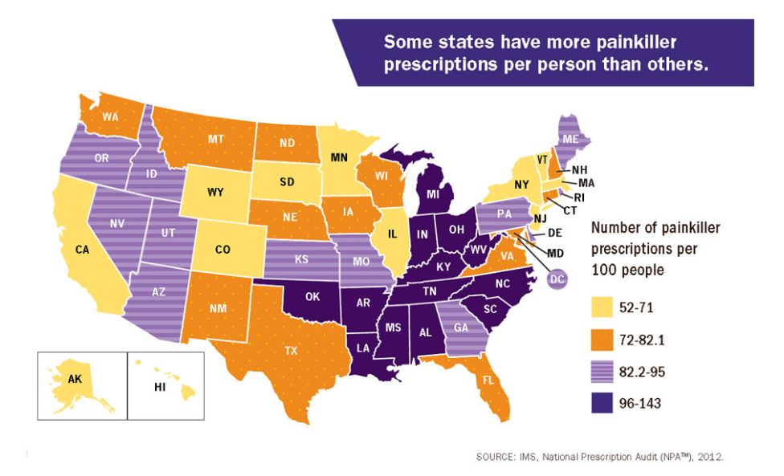

Slide 20
"We know of no other medication routinely used for a nonfatal condition that kills patients so frequently.“
~ Dr. Thomas Friedan, CDC

Slide 21
Underlying the perfect storm
Stigma
Discrimination

Slide 22
Consider the human in bed 1
A 68 year old man is presenting to the emergency room of a large teaching hospital a few miles from here.
He has crushing sub-sternal chest pain that radiates down his left shoulder.
He’s sweating, having trouble breathing, and in significant distress.
Within seconds, he’s diagnosed with an acute myocardial infarction (a heart attack).
In near real-time he’s given multiple FDA-approved medications that help alleviate his symptoms.
And of course, he’s visited at the bedside by a board-certified cardiologist.
He may have surgery or a procedure
He will be released into the care of a cardiologist already on the appropriate medications

Slide 23
Now consider the humans in Beds 2, 3, 4
In Bed 2 there is a man with a severe abscess in his elbow from injection drug use. The doctor doesn’t want to give him pain medications because “he’s an addict”.
In Bed 3 there is a woman in severe opioid withdrawal that is vomiting and feels worse than she’s ever felt in their life. She’s also pregnant and thinking about walking out of the ER before the staff realizes she’s pregnant and calls Children Services.
In Bed 4 there is a 22 year old who was found unresponsive due to an opioid overdose for the 4th time this month.

Slide 24
Stigma is entrenched in medicine
None of them is likely to see a board-certified addiction medicine physician.
Odds are, there will be no fellows, no residents, and certainly no medical students.
Why is this?
Why does the disease of the heart receive so much more attention than the disease of the mind?
Why don’t the medical students want to become addiction medicine physicians instead of cardiologists?
Is the heart that interesting?

Slide 25
Origins of stigmatization in medicine
Until relatively recently, addiction care was provided in church basements, recreation centers, and asylums with little to no oversight
Viewed as outside the purview of physicians
1864: NY Opens “Inebriate Asylum”
1867: Chicago opens Martha Washington Home for “inebriate women”
1879: Dr. Leslie Keeley announces “Drunkeness is a disease and I can cure it”, opens 120 for-profit institutions giving sham injections of “gold”
1900s: expansion of “inebriate homes”, known as “drunk tanks”, “cells”, “jitter joints”.
1952: Ruth Fox establishes NYC Medical Society on Alcoholism, precursor to ASAM

Slide 26
Population
with Untreated Pain
Population in Alternative Treatment
Population
using Rx Opioids
Population
Misusing Rx Opioids
Population
Misusing Non-Rx Opioids
Population
Dying From Opioid Ovedose
Population engaged
in Treatment
Population
in
Recovery

Slide 27
Source: Michigan Resident Death Files (2004-2013)
*Source: Ingham County Medical Examiner Records 2014 – 2019
† Data is current as of 1/6/2020.

Slide 28
Source: Ingham County Medical Examiner Records 2019
*Data is current as of 1/6/2020

Slide 29
Source: Ingham County Medical Examiner Records 2019
*Data is current as of 1/6/2020

Slide 30
Source: Ingham County Medical Examiner Records 2019
*Data is current as of 1/6/2020

Slide 31
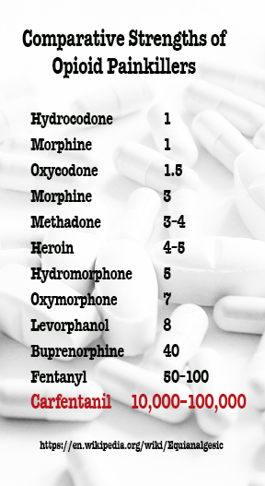
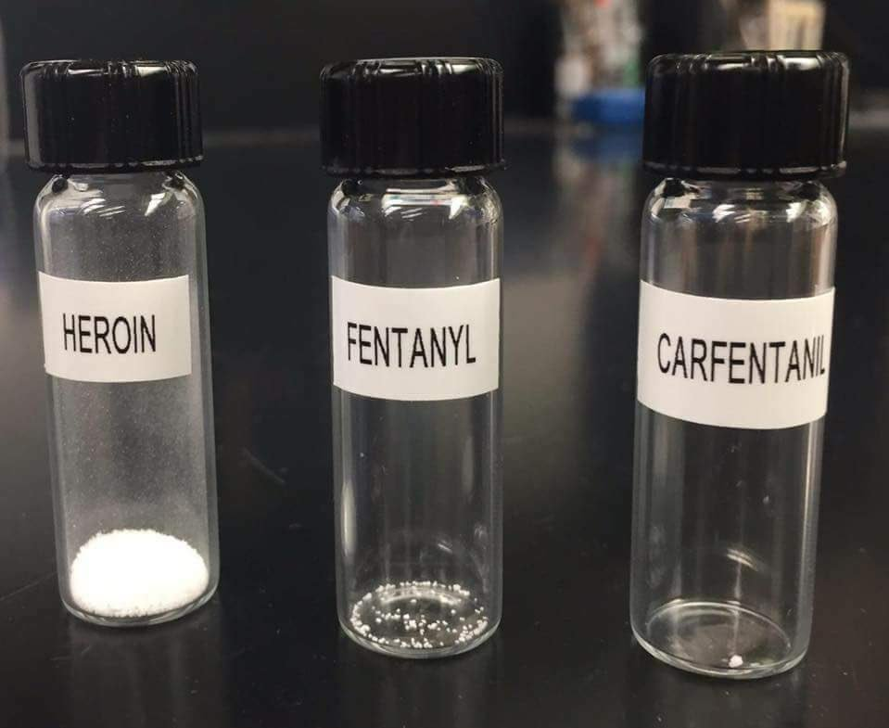
Carfentanil in an amount equivalent
to one grain of salt is enough
to kill a human being

Slide 32
Source: Ingham County Medical Examiner Records 2019
*Data is current as of 3/19/2019

Slide 33
Source: City of Lansing Fire Department/EMS
*Data is current as of 3/19/2019
Notes:
Aftre opening at work computer(chc color) save this slide as image in different slide & delete this because this has data table linked

Slide 34
Source: City of Lansing Fire Department/EMS
*Data is current as of 1/6/2020

Slide 35
Source: City of Lansing Fire Department/EMS,
*Data is current as of 1/6/2020
**NI= not identified

Slide 36
Source: City of Lansing Fire Department/EMS,
*Data is current as of 1/6/2020
**NI= not identified

Slide 37
Source: City of Lansing Fire Department/EMS,
*Data is current as of 1/6/2020

Slide 38
Michigan 10-bill Package Became Law in 2018
PA 246 Informed consent with minors
PA 247 Provider relationship with patient
PA 248 MAPS requirement
PA 249 Corrects any conflicts in statute
PA 250 Provider treating overdose must provide SUD info
PA 251 Limits first time Rx to 7 days, pharmacy may fill in increments
PA 252 Veterinary dispensing added to MAPS
PA 253 Medicaid coverage of opioid abuse treatment PA 254 MDHHS to develop and make recommendations to MDE for pupil instruction
PA 255 Incorporating dangers of Rx opioid abuse into public education

Slide 39
A Health Equity Lens
Health Equity
Health Equity
Harry Anslinger
The New Jim Crow
White
Men
Age 25-34

Slide 40
Narrative
A collection or system of related stories, articulated and entrenched over time to represent a central idea or belief
Photos from “Let’s Talk About Race”, O, The Oprah Magazine, May 2017.

Slide 41
Dominant Narrative
Dominant narratives are those stories we tell ourselves, learn, or share with others—whether consciously or unconsciously—that also uphold existing power dynamics. They celebrate or absolve groups who already hold power, or demonize or blame those who are marginalized. Frequently, they are accepted and circulated widely without (much) critical thinking or conversation devoted to them, rendering them particularly insidious.

Slide 42
In what year was this the prevailing opinion in medicine, science and society?
Narcotics, when made available, are managed well by the majority
A small percent will become addicted
Those people need compassion and treatment
1918

Slide 43
Creating a New Dominant Narrative:The Impact of Harry Anslinger
1st Commissioner of the Federal Bureau of Narcotics
In office August 12, 1930 – May 1962

Slide 44
The Dominant Narrative Lives On: The War on Drugs
“The Nixon Campaign in 1968 and the Nixon White House after that had two enemies: the anti-war left and black people.” ~ former domestic policy chief, John Erlichman.
Dan Baum, “Legalize It All: How to win the war on drugs.” Harper’s Magazine. April, 2016

Slide 45
The New Jim Crow

Slide 46
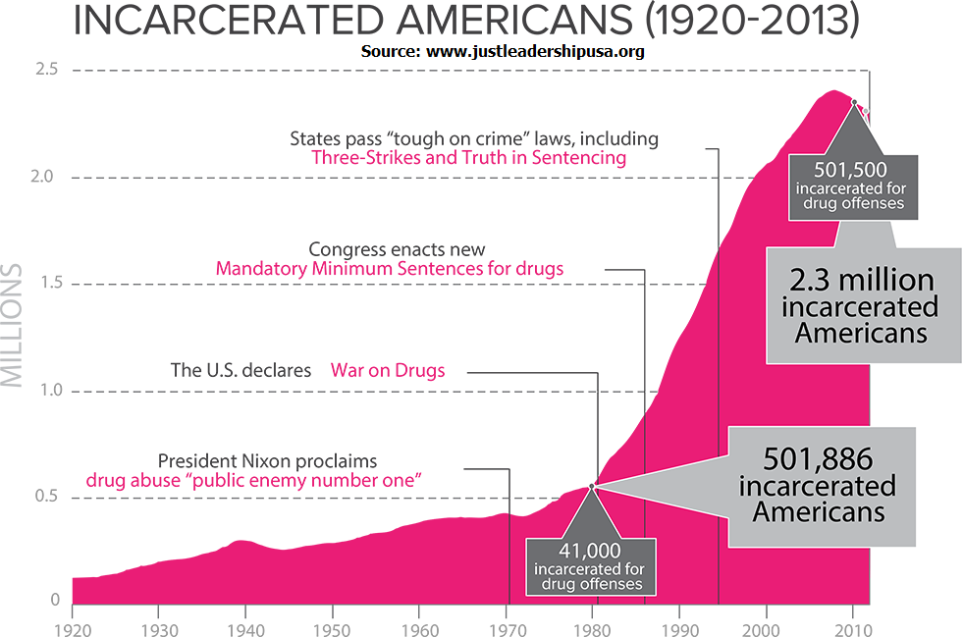
The New Jim Crow

