Slide 1
Psychological Management of Chronic Pain
John Jerome Ph.D.
Pain Psychologist
Evan Goodman Ph.D.
Pain Psychologist

Slide 2
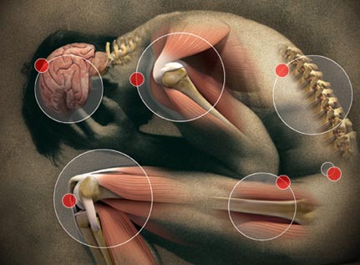
WHAT IS PAIN ?
“unpleasant sensory and emotional experience associated with actual or potential tissue damage, or described in terms of such damage”
International Association for the Study of Pain (IASP), 1979

Slide 3
Chronic Pain
Serves no biological
Continues long after damage and healing
Redundant, noxious
Itself is disabling
Notes:
Effects mood, sleep, work, and function.

Slide 5
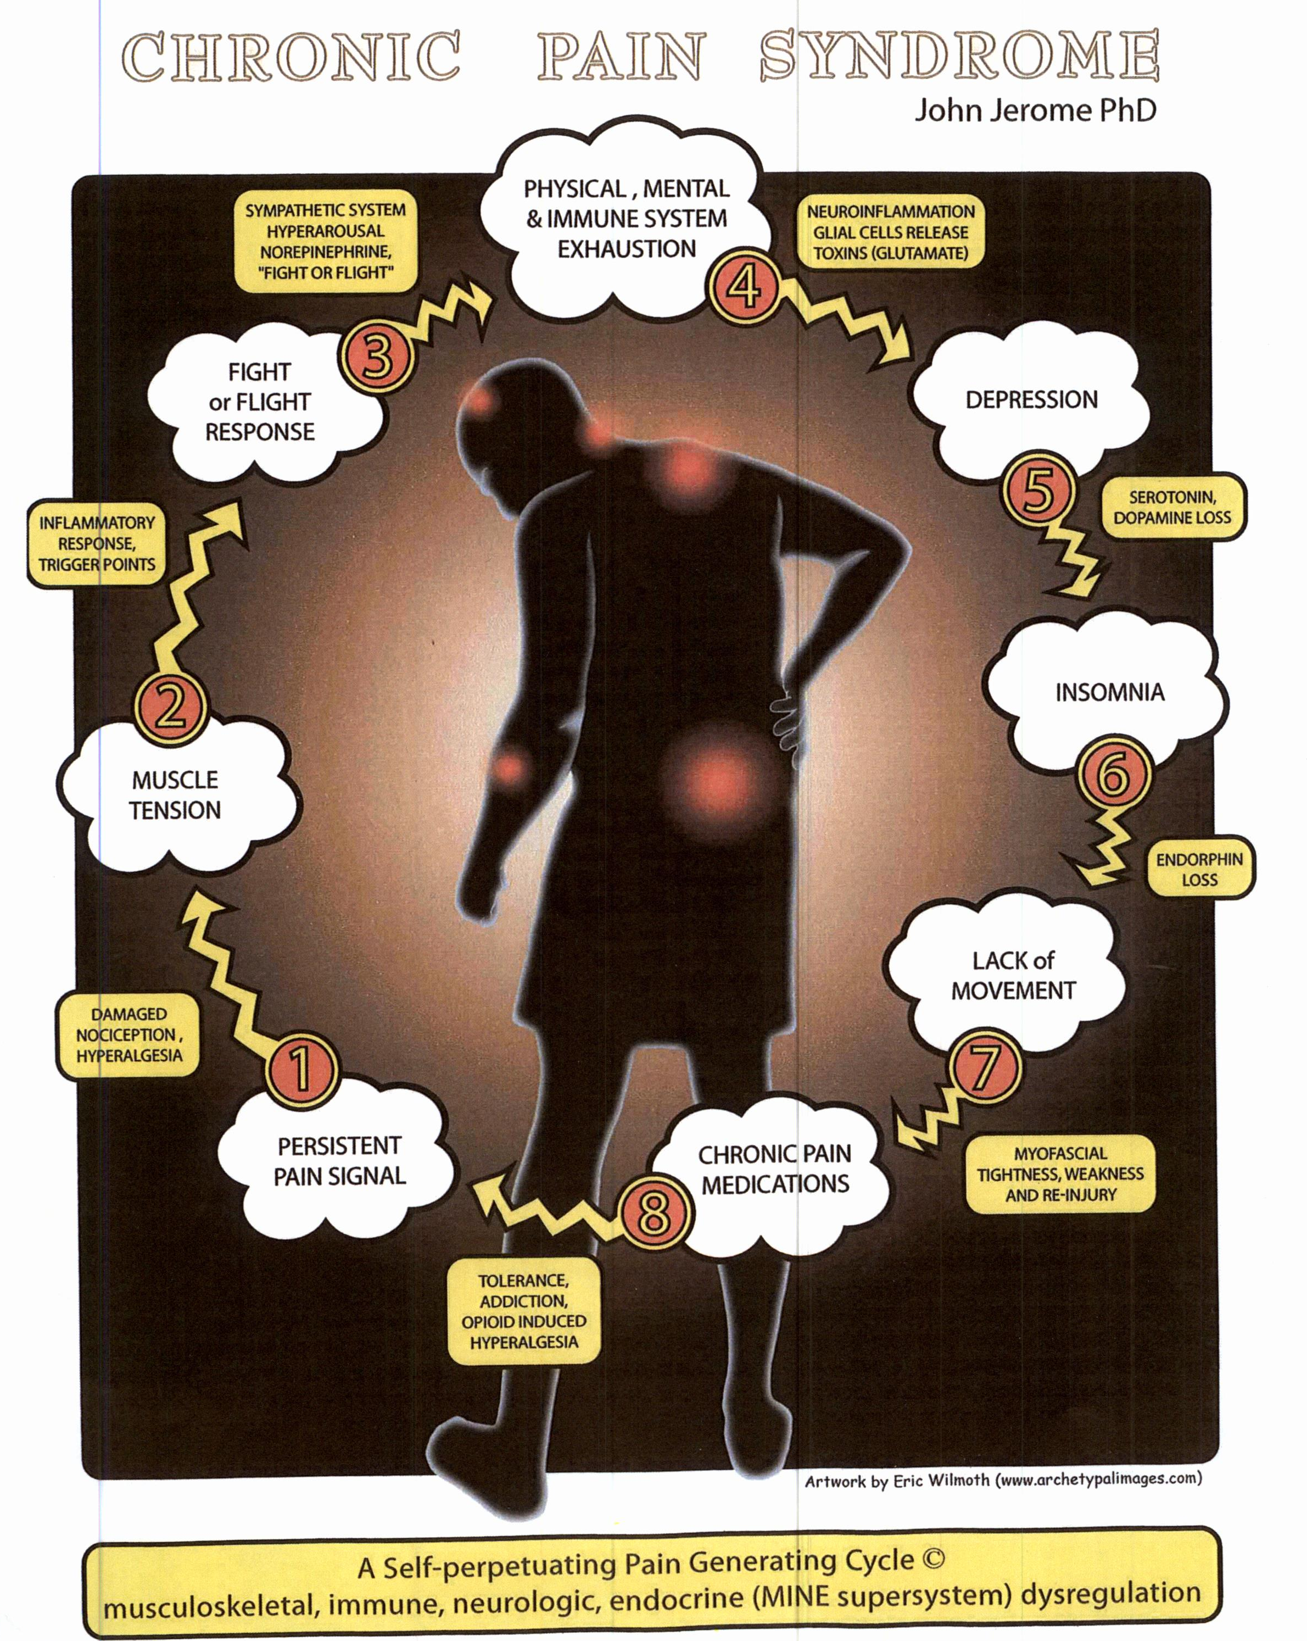

Slide 6
Patients have three simple questions:
Why do I have the pain?
Is this something that will harm me?
What can you do to stop it?

Slide 7
Patients have three fears:
Underlying malignancy, tumor, cancer, crippling, shortened life!
There’s nothing wrong and the pain is in my head!
I will have to live the rest of my life in pain!!!

Slide 8
“Where do I start?”

Slide 9
Setting Goals
Reduce pain to a tolerable level
Restore function physically , psychologically and vocationally
Reduce the impact of pain (on the patient, their
family and lifestyle)
Reinstitute patient responsibility (I do/ you do)
Learn cognitive behavioral pain coping strategies

Slide 10
PAIN COPING BELIEFS
My pain is real
I may need outside help
At times my pain is an overwhelming influence
My best efforts and those of the medical community have not stopped my pain…. This is not a fault of mine…. or shortcoming of medicine
Some aspects of my coping is working well

Slide 11
PAIN COPING BELIEFS (cont)
Forgive yourself, others, and fix whatever….
Hold two ideas: pain may pass….. I have to cope with the pain I have
Pain > side issue
Recognize more to life than struggling
Strive toward higher goals
Gradually separate myself from pain management…….. and self manage.

Slide 12
TAKE-HOME MESSAGE 8
I am not a “pain patient”…. But more of a person coping, surviving, adapting and growing
I’m done grieving what was lost….. I am accepting what’s left….. And I look to what can now be!!

Slide 13
Meaning and Purpose

Slide 14
BRAIN HEART BODY
“there's no useless bodies…….only useless hearts…….”
New Zealand Paralympics rugby player

