Slide 2
Treatment and Recovery Program Exemplar
Rae Green, JD, LPC, CAADC
Founder & President, Sanford Addiction Treatment Centers

Slide 3
Evidence - Based Interventions are practices or programs that have peer-reviewed, documented empirical evidence of effectiveness.
Evidence - Based Practice is a process in which the practitioner combines well-researched interventions with clinical experience, ethics and culture to inform delivery of treatment and services.

Slide 4
CBT
DBT
Matrix
Model
BI
MI
Mindfulness
MAT
CM
RP

Slide 5
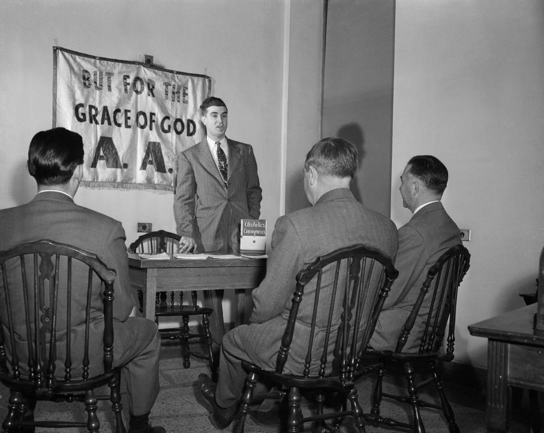

Slide 6
The Surgeon General’s Report on Alcohol, Drugs, and Health (2016)
“MAT is a highly effective treatment option for individuals with alcohol and opioid disorders. Studies have repeatedly demonstrated the efficacy of MAT at reducing illicit drug use and overdose deaths…”
MAT

Slide 7
Therapeutic Alliance and Medical Model

Slide 10
According to The Surgeon General’s Report, 41.2% of those with substance use disorders also have co-occurring mental health disorders.

Slide 11
“Building a relationship with a therapist is certainly a key component to long-term recovery. But I think that a sense of belonging in an accepting, non-judgmental group is the most important thing we can help those with substance use disorders achieve to rebuild their lives. When a person feels the pain their behavior is causing, they are ready to change. They stop blaming others for their disease. And when we educate the whole environment this person lives and functions in – family, employers, friendships, we provide a healthy foundation for their recovery long term.”
- Carli Parmelee-Noffsinger, LMSW,CAADC

Slide 12
Chronic Disease Management

Slide 13
Length of Stay – What is realistic?

Slide 14
Continuum of Care

Slide 15
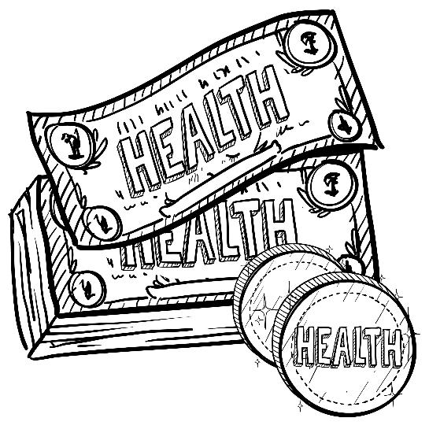
Tackling the Cost of Treatment

Slide 16
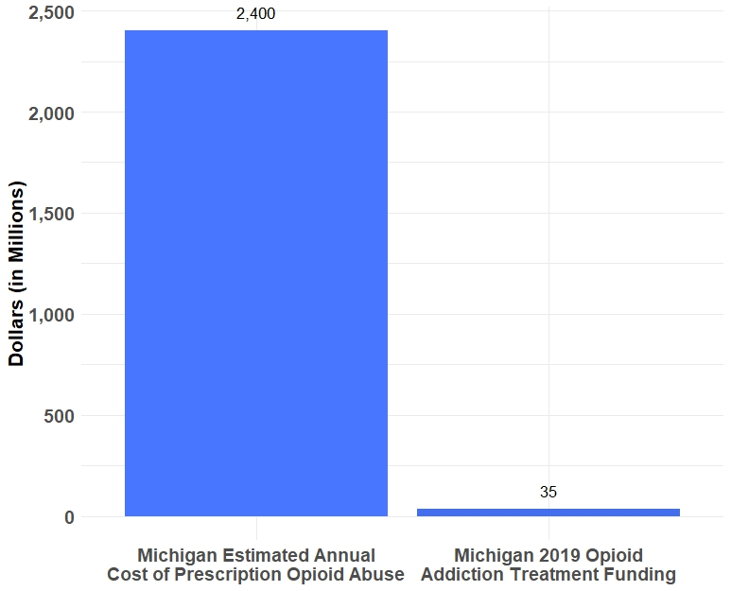
Economic Burden

Slide 17
What is unique about Michigan?

Slide 18
Employees with SUDs miss 50% more work than their peers.
Employees in active addiction are 3 times more likely to be in a workplace accident.
Healthcare costs are twice as much for someone with an SUD.
Employees with SUDs make more ER visits than other employees.
1 in 5 people say working with someone with an SUD is more dangerous and harder.

Slide 20
Prediction and Misuse

Slide 21
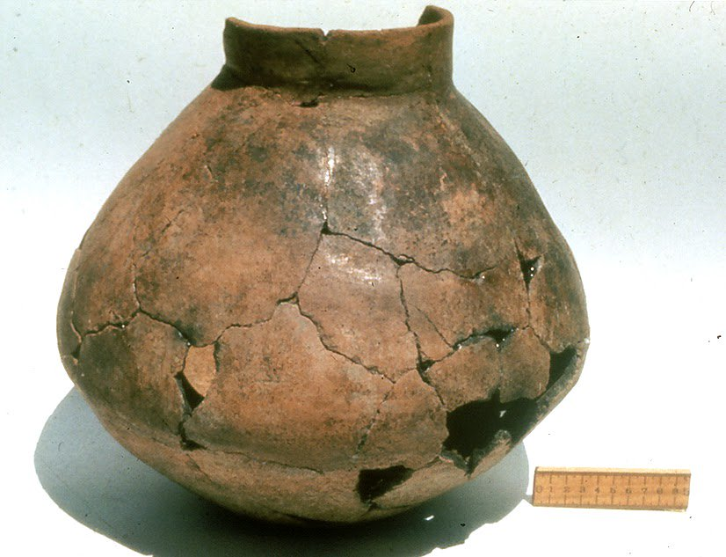
Since the dawn of time...

Slide 22
The world is a stressful place…

Slide 23
The Mental Health Parity and Addiction Equity Act of 2008

Slide 26
Public Funding

Slide 27
Outcome Data

Slide 28
