Slide 1
Non-Pharmacologic Management of Musculoskeletal Pain Syndromes
Considerations for Spinal Manipulation and Osteopathic Neuromusculoskeletal Medicine
Jesse Guasco, DO
Departments of Osteopathic Manipulative Medicine and Psychiatry
Michigan State University

Slide 2
The Problem – As Reported by The CDC
More than 11.5 million Americans, aged 12 or older, reported misusing prescription opioids in 2016.
An estimated 11% of adults experience daily pain
Millions of Americans are treated with prescription opioids for chronic pain
Primary care providers are concerned about patient addiction and report insufficient training in prescribing opioids.
Notes:
The problem that physicians are faced with is the overwhelming amount of opioid misuse in America. Yet so many adults suffer with chronic daily pain that depend on opioids to function. It leaves a gap in knowledge for primary care providers.

Slide 3
The Problem
Chronic pain is not a disease but a constellation of symptoms.
If effective chronic pain treatment reduces the risk of opioid use disorder, then its critical to understand and treat the etiology of pain.
Notes:
My goal today Is to discuss ways for primary care physicians to address chronic and recurrent acute exacerbations musculoskeletal pain

Slide 4
Chronic Pain Syndromes
Chronic headaches, migraines, neck and low back pain
  Most have clear objective musculoskeletal and biomechanical components to their etiology
Significant correlation between these pain syndromes and cumulative, postural or exercise overuse or biomechanical changes after trauma.

Slide 5
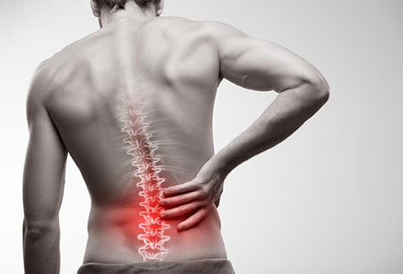
Non-Specific Low Back Pain
Notes:
According to the WHO Low back pain is a very common health problem worldwide and a major cause of disability - affecting performance at work and general well-being. Low back pain can be acute, sub-acute, or chronic and often recurrent. Although several risk factors have been identified (including occupational posture, depressive moods, obesity, body height and age), the causes of the onset of low back pain remain obscure and diagnosis difficult to make. Back pain is not a disease but a constellation of symptoms. In most cases, the origins remain unknown.
The 2010 Global Burden of Disease Study estimated that low back pain is among the top 10 conditions that account for the highest disability worldwide. It is difficult to estimate the incidence of low back pain as the incidence of first-ever episodes of low back pain is already high by early adulthood and symptoms tend to recur over time. The lifetime prevalence of non-specific (common) low back pain is estimated at 60% to 70% in industrialized countries (one-year prevalence 15% to 45%, adult incidence 5% per year). The prevalence rate for children and adolescents is lower than that seen in adults but is rising.2,3 Prevalence increases and peaks between the ages of 35 and 55.4

Slide 6

Non-Specific Low Back Pain
Radiculopathies are easily ruled out, neurologically intact individual, no red-flags.
Muscular etiology of pain:
  Iliopsoas, quadratus lumborum, piriformis, erector spinae
  Non-radicular pain referral to the lower extremity is common
Indication of clinical instability which can lead to spinal instability which is defined by spondylosis and spinal stenosis.
Notes:
Non-specific low back pain is by definition non-radicular and not visceral. A great majority of low back pain has a muscular origin, which is easily treated conservatively… at least initially. However, pain recurrences are common and as the years pass the patient will eventually have DDD and potentially surgery may be discussed. By then the patient has chronic pain and is a poorer candidate for surgery and more likely to become addicted after surgery. Just like a patient with hypertension or diabetes is at risk for heart disease, the patient with chronic low back pain is at risk for spinal instability, which has implications for addiction and disability.

Slide 7
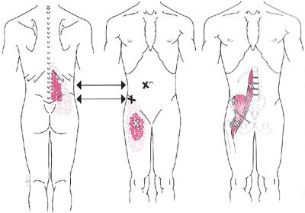
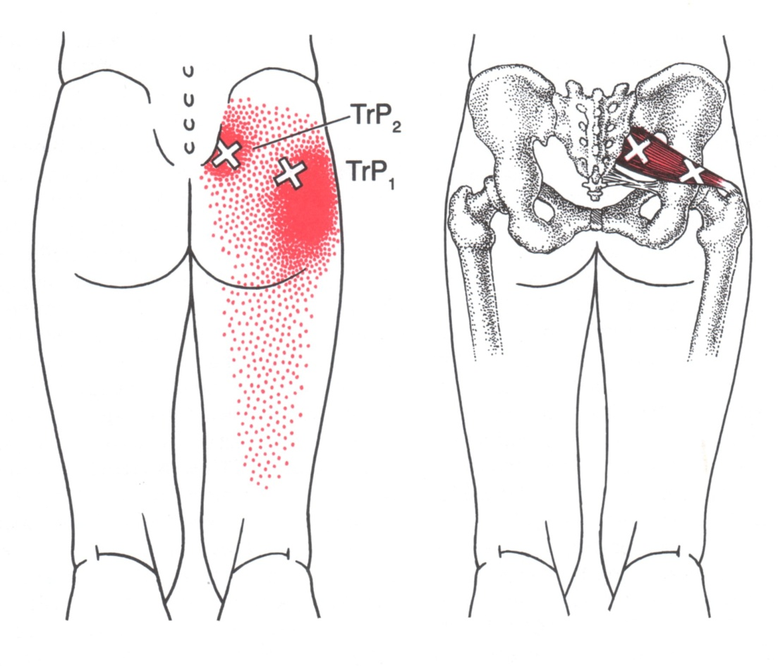
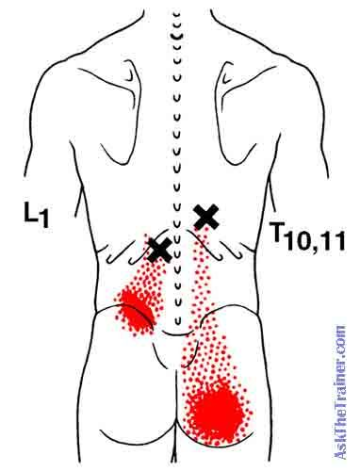
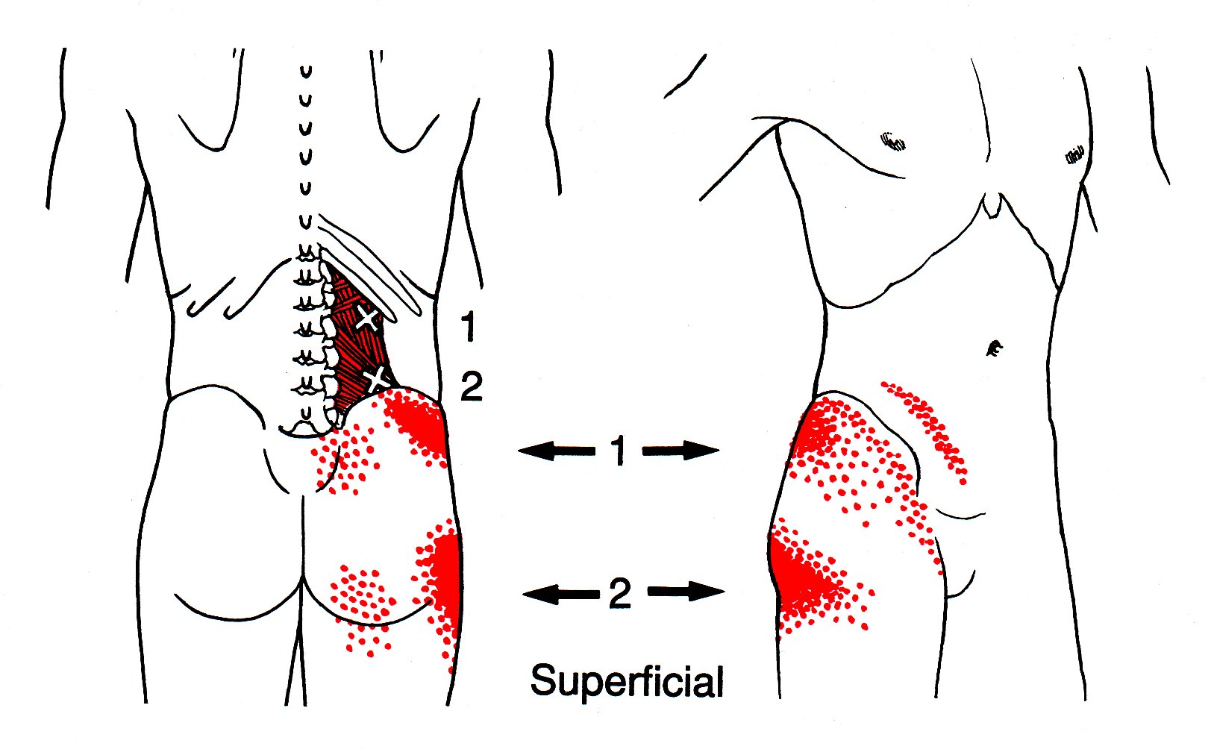
Notes:
These are examples of the common muscle referral pain patterns that we often see with patients who present with low back pain. These pain patterns indicate clinical instability of the spine.

Slide 8
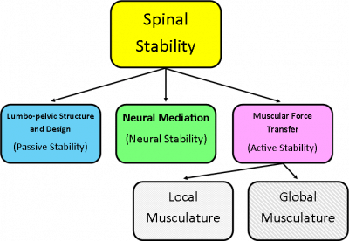
Notes:
Spine stability requires joint stability.
Joint stability requires active (muscular), passive (joint capsule/disc) and neural subsystems (central/peripheral/reflex) of each segment are working optimally.
The arthrokinetic reflex was coined by medical researchers at the University of Pittsburgh medical school department of physiology in 1956 to refer to the way in which joint movement can reflexively cause muscle activation or inhibition. The prefix “arthro” means joint “kinetic” signifies motion, and reflex in humans refers to an involuntary movement in response to a given stimulus. Thus the arthrokinetic reflex refers to the involuntary response that happens when a joint is moved, namely that relevant muscles fire reflexively.
Relevant muscles are stabilizers of the joint or the local musculature, global muscles are the big trunk movers and global stabilizers such as quadratus lumborum and iliopsoas. Joint dysfunction alters the arthokinetic reflex because the mechanoreceptors in the joint are unable to stimulate the muscular response.

Slide 9
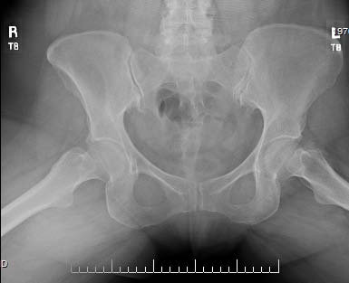
Non-Specific Low Back Pain
Joint dysfunction
Arthrokinetic reflex dysfunction
Overload of ligaments, joint capsules and intervertebral discs
Facilitation of global musculature
Degenerative disc disease
Pain with exacerbations
Notes:
In low back pain, joint dysfunction leads to arthrokinetic reflex dysfunction, which causes the lumbar spine to depend on non-stabilizing musculature for stability. This leads to overload/overworked muscles and facilitation of the global musculature leading to DDD and pain.
Pic: exostosis of sacroiliac joint - a benign outgrowth of cartilaginous tissue on a bone often due to tissue irritation

Slide 10
Decreasing the Incidence of Chronic Low Back Pain
Don’t wait!
Critical to eliminate joint dysfunction related arthrokinetic inhibition….
…prior to strengthening or stretching, or MRI or injections.
Notes:
DDD indicates that there has been long standing clinical instability. This can occur in the absence of pain if the patient is very strong. If they do begin to have pain, we still have to address the instability.

Slide 11
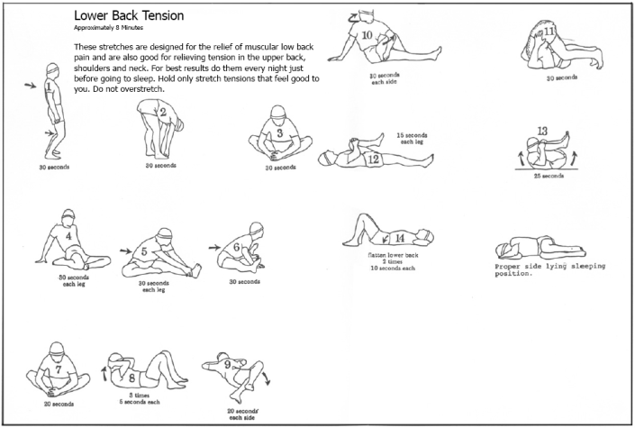
“Destabilizing Stretches”
Notes:
Although conservative treatment is ideal, giving patients stretch’s to target their pain or to lengthen their hamstrings in fact further destabilizes the spine. Its important to treat the etiology of the pain which is the joint dysfunction, this optimized the active passive and neural subsystems for joint stability which works to decrease the patient's pain and stiffness. Then adding in stretching and strengthening is optimal.

Slide 12
Neck Pain
Notes:
Chronic neck pain very often is a postural muscle overuse condition. Neck muscles are meant to turn head not hold it up in slouched position.

Slide 13
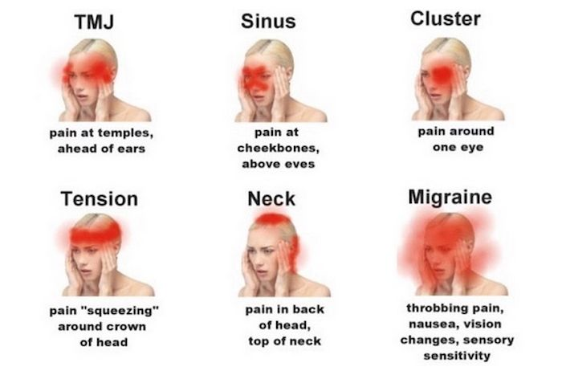
Headaches or Migraines
Notes:
According to CDC in 2015, 20% of women and 9.7% men 18 and older had a severe headache or migraine in the past 3 months – significant disability and financial burden on society

Slide 14
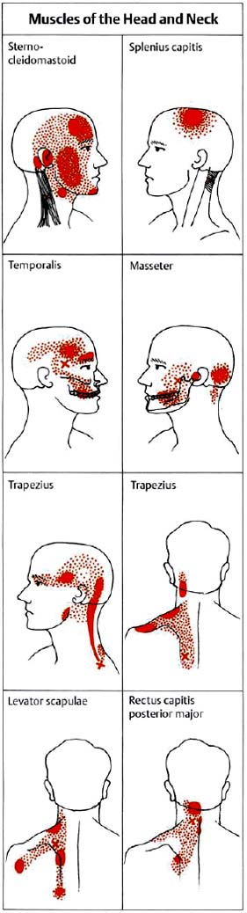
Pain Referral Patterns to the Head and Neck
Notes:
Headaches, particularly Tension-type (the most common HA disorder) often have a muscular and therefore joint etiology (a significant component at least)

Slide 15
Addressing the Headache Etiology
Posture or overuse
Bruxism or clenching
TMJ or TMD
Trauma
  Head injury
  Brain injury
  Concussion
Cervical spine stability relative to the head and thorax
Muscular referral
Trigemino-Cervical Reflex
Notes:
Reflex interaction between nociceptive trigeminal afferents and both upper and lower cervical spinal cord motoneurons. Considered a withdrawal reflex, the TCR is often triggered after trauma, such as whiplash.

Slide 16
Multidisciplined Treatment Approach
Physical Therapy
Behavioral Therapy
Spinal Manipulation
Spinal or Intramuscular Injections
Non-Opioid Analgesics
Muscle Relaxers
Notes:
Now that we have provided a small introduction into the etiology of common chronic musculoskeletal pain syndromes it should be easier to understand why a multidisciplined treatment approach is optimal. In addition to physical therapy it is critical to address the postural behaviors in chronic pain. Spinal manipulation is also critical in addressing joint dysfunction related arthro-kinetic reflex issues. Doing so may eliminate the need to perform spinal or intramuscular injections or maintain the patients on analgesics and muscle relaxors.

Slide 17
Definition of Spinal Manipulation
..the use of the hands in a patient management process using instructions and maneuvers to achieve maximum painless, movement of the musculoskeletal (motor) system in postural balance.
Notes:
Consensus statement.

Slide 18
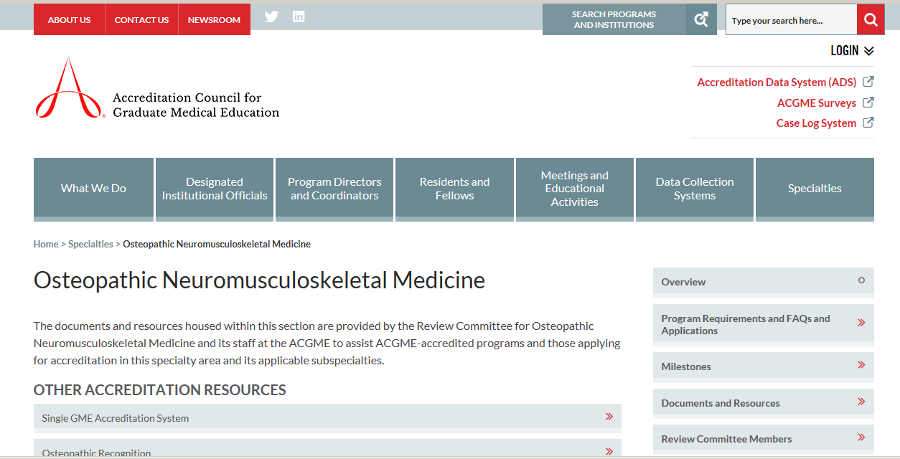
Osteopathic Neuromusculoskeletal Medicine - ONMM
Notes:
The osteopathic neuromusculoskeletal medicine residency program is a primary residency disciplined in the neuromusculoskeletal system, its comprehensive relationship to other organ systems, and its dynamic function of locomotion.
The principle focus of the discipline is osteopathic and patient-centered; specifically, it embodies structural and functional interrelation, body unity, self-healing, and self-maintenance.
Specialists in this discipline must interpret and demonstrate specialized knowledge of the basic and clinical sciences, clinical evaluation, and management of disorders of the neuromusculoskeletal system and its related visceral and somatic structures.
Specialists in this discipline demonstrate knowledge of the indications, risks, and benefits of manipulative medicine in treatment of patients with neuromusculoskeletal disorders.

Slide 19
ONMM vs Chiropractic
Although both use joint manipulation
  chiropractors tend to limit the technique to the spine
  chiropractors are limited by x-rays to diagnose
  chiropractors are focus on position of the spine rather than restoring function of the musculoskeletal system

Slide 20
Management of Recurrent Acute Exacerbations of Chronic Pain
Necessary for many reasons:
  Lowers the risk for the patient and cost of care
    Less studies
    Fewer injections
    Fewer PT visits
    Less medications
  Decreases anxiety and fear-based avoidance of movement.
  Decreases incidences of disability or work time loss.
  Decreases PCP burden.

Slide 21
References
Wyke BD. Temporomandibular Arthrokinetic Reflex Control of the Mandibular Musculature.) British Journal of Oral Surgery (1975), 13, 196-202.
Ramcharan JE, Wyke B. Articular reflexes at the knee joint: an electromyographic study. Am J Physiol. 1972;223(6):1276-1280. doi:10.1152/ajplegacy.1972.223.6.1276
Cohen LA, Cohen ML. Arthrokinetic reflex of the knee. Am J Physiol. 1956;184(2):433-437. doi:10.1152/ajplegacy.1956.184.2.433
Coulter ID, Crawford C, Hurwitz EL, et al. Manipulation and mobilization for treating chronic low back pain : a systematic review and meta-analysis. Spine J. 2018;18(5):866-879. doi:10.1016/j.spinee.2018.01.013
Cohen SP, Hooten WM. Advances in the diagnosis and management of neck pain. BMJ online. 2010:1-19. doi:10.1136/bmj.j3221

