Slide 1
Opioid Misuse in Marginalized Communities
Culturally-Responsive Solutions for LGBTQ+ Populations
Kaston D. Anderson-Carpenter, Ph.D., M.P.H., BCBA-D, LBA

Slide 2
Overview
Incidence & prevalence of opioid misuse in marginalized communities
Influencing factors of opioid misuse
Cultural competence, cultural humility, and cultural responsiveness
Strategies and frameworks for prevention and treatment

Slide 3
Heterosexual vs. LGB Prevalence¹

Slide 4
Gender & Age Differences in LGB¹
Capistrant & Nakash (2019). Lesbian, gay, and bisexual adults have higher prevalence of illicit opioid misuse than heterosexual adults: Evidence from the National Survey on Drug Use and Health, 2015-2017. LGBT Health, 6(6), 326-330. doi: 10.1089/lgbt.2019.0060

Slide 5
LGB vs. Heterosexual Veterans²
Bisexual adults have greater lifetime odds
Overall: > 3.0
Men: > 2.5
Women: > 4.0
Bisexual women have ~3.5 times greater odds of past-year misuse

Slide 6
LGB vs. Heterosexual Rural Adults³
Bisexual adults have greater lifetime odds
Overall: > 2.0
Men: ~ 2.0
Women: > 2.6
Past 12 months
Lesbian or gay: ~1.75
Bisexual: <2.0
Bisexual women: <2.75
Anderson-Carpenter, K. D., & Tacy, G. S. (in preparation). Social cofactors of prescription opioid misuse in lesbian, gay, and bisexual versus heterosexual rural adults: Evidence from the 2015-2018 National Survey of Drug Use and Health.

Slide 7
Correlates of nonmedical Rx drug use among transgender adults⁴
HIV (44%)
Clinical mental health concern, lower self-esteem
Greater perceived discrimination based on gender ID

Slide 8
Influencing Factors of Opioid Misuse

Slide 9
First, a Focus on Identity
Who are you?
What are your identities?
How do they shape how you navigate the world?
What advantages and/or obstacles have you faced based on your identity?

Slide 10
Minority Stress Model⁵
Coping and Social Support
General Stressors
1. Minority stress processes (distal)
-Prejudice events (discrimination, violence)
Outcomes (positive & negative)
Environmental circumstances
Minority status (e.g., sexual orientation, race/ethnicity, gender ID)
2. Minority stress processes (proximal)
-expectations of rejection
-concealment
-Internalized homophobia
Sexual minority identity
Characteristics of minority identity
-prominence
-valence
-integration

Slide 11
What is Intersectionality?
Interplay between race, class, gender, and other identities^{6,7}
Creating overlapping and interdependent systems of discrimination or disadvantage

Slide 12
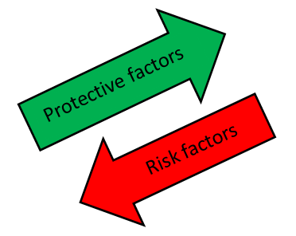
Risk & Protective Factors
Risk factors
Self and/or family rejection
Stigma & discrimination
Abuse & harassment
Protective factors
Sense of community
Social support
Expanded options
This Photo by Unknown Author is licensed under CC BY-SA

Slide 13
Small Group Discussion
What are some additional risk factors you see in your practice?
What are some protective factors?

Slide 14
Cultural Competence, Cultural Humility, & Cultural Responsiveness

Slide 15
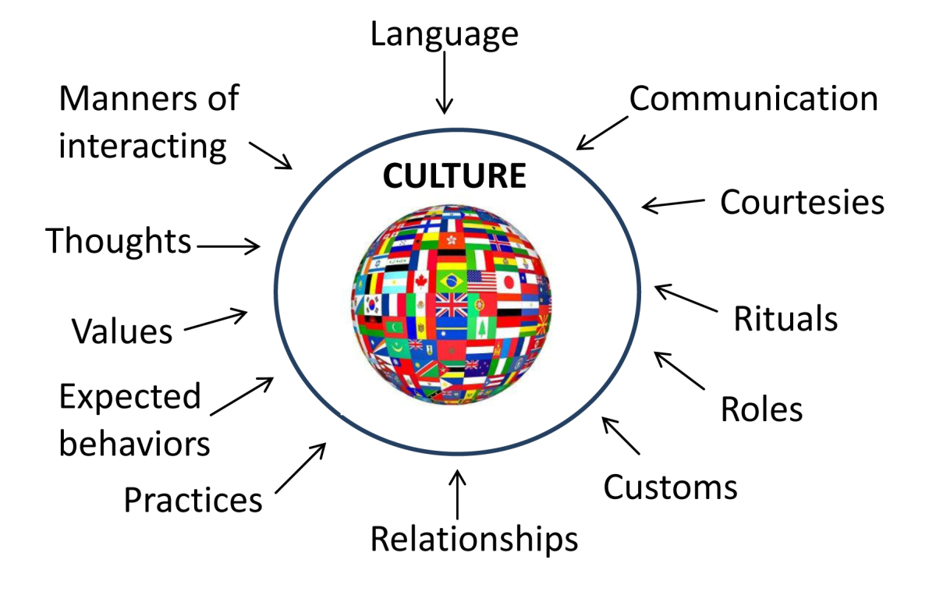
What’s the Difference?
Cultural Competence
Understand other cultures to provide services better & more appropriately
Values knowledge & training
Cultural Humility
Personal reflection & growth around cultures to increase awareness
Values introspection & co-learning

Slide 16
What’s the Difference?
Cultural Competence
We can never be “certified” in a culture
Aspirational & promotes skill building
Cultural Humility
No end result
Attempts to minimize damaging power dynamics

Slide 17
Cultural Humility in Practice
Lessons from my experience
Another example: University of Pittsburgh Community Engagement Centers

Slide 18
Small Group Discussion
How do you (or can you) promote cultural humility in your practice—with patients/clients, colleagues, or both?

Slide 19
Trauma-Informed Strategies for Prevention and Treatment

Slide 20
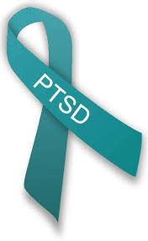
Trauma & Health
Trauma associated with⁸
Lower ART medication adherence
Greater mental health symptoms
Greater opioid misuse
Lower social health and general well-being

Slide 21
Strategy #1: Consider the Theory
Feminist theory → accounts for legal, economic, & social context of women’s lives
Queer theory → sexual orientation, gender roles, & gender ID are social constructs
Notes:
Feminist theory addresses the many oppressions that women experience
Queer theory—constructs can be questioned, subverted, and self-constructed

Slide 22
Strategy #2: LGBTQ-Welcoming & Affirming Clinics
Building capacity:
Ongoing training in providing services for LGBTQ
Ask questions!
Environmental changes:
Welcoming and affirming materials & signage
Gender-inclusive restrooms
Inclusive intake forms

Slide 23
Strategy #2: Community Engagement
Suppress negative effects of stigma on healthcare utilization⁹
Lower stigma, harassment, and abuse
Providers have a critical role in promoting community engagement & social support in reducing opioid misuse and OUD
Notes:
Outreach is important; go where they are.
Listen to the communities

Slide 24
Strategy #3: Holistic Approaches
Spiritual or religious leaders
Medical professionals
Psychologists, LPCs, LCSWs, recovery therapists
University or academic researchers
Peer support & community leaders
BCBAs/LBAs, behavior therapists

Slide 25
Conclusion

Slide 26
Key Takeaway Messages
Trauma faced by LGBTQ clients/patients is unique.
Integrating client/patient lived experience is critical to culturally-responsive care.
Interdisciplinary and holistic approaches can support trauma-informed prevention and treatment.

Slide 27
Kaston D. Anderson-Carpenter, Ph.D., M.P.H., BCBA-D, LBA
Assistant Professor of Psychology
Core Faculty, MSU Consortium for Multicultural Psychology Research
Affiliate Faculty, MSU Institute for Public Policy and Social Research
Michigan State University
Psychology Building
316 Physics Road, Room 238
East Lansing, MI 48824
Phone: (517) 432-0686
Email: kaston@msu.edu
Pronouns: he/him/his

Slide 28
References
1. Capistrant, B. D., & Nakash, O. (2019). Lesbian, gay, and bisexual adults have higher prevalence of illicit opioid misuse than heterosexual adults: Evidence from the National Survey on Drug Use and Health, 2015-2017. LGBT Health, 6(6), 326-330. doi: 10.1089/lgbt.2019.0060
2. Anderson-Carpenter, K. D., Rutledge, J. D., & Mitchell, K. (2020). Prescription opioid misuse among heterosexual versus lesbian, gay, and bisexual military veterans: Evidence from the 2015-2017 National Survey of Drug Use and Health. Drug and Alcohol Dependence. doi:10.1016/j.drugalcdep.2019.107794
3. Anderson-Carpenter, K. D., & Tacy, G. S. (in preparation). Social cofactors of prescription opioid misuse in lesbian, gay, and bisexual versus heterosexual rural adults: Evidence from the 2015-2018 National Survey of Drug Use and Health.
4. Benotsch, E. G., Zimmerman, R., Cathers, L., McNulty, S., Pierce, J. Heck, T., . . . Snipes, D. (2013). Non-medical use of prescription drugs, polysubstance use, and mental health in transgender adults. Drug and Alcohol Dependence, 132, 391-394. doi: 10.1016/j.drugalcdep.2013.02.027
5. Meyer, I. H. (2003). Prejudice, social stress, and mental health in lesbian, gay, and bisexual Populations: Conceptual issues and research evidence. Psychological Bulletin, 129(5), 674-697.
6. Crenshaw, K. (1989). Demarginalizing the interaction of race and sex: A Black feminist critique of antidiscrimination doctrine, feminist theory and antiracist policies. University of Chicago Legal Forum(1), 139-167.
7. Crenshaw, K. (1991). Mapping the margins: Intersectionality, identity politics, and violence against women of color. Stanford Law Review, 43(6), 1241-1300.
8. Cuca, Y. P., Shumway, M., Machtinger, E. L., Davis, K., Khanna, N., Cocohoba, J., & Dawson-Rose, C. (2019). The association of trauma with the physical, behavioral, and social health of women living with HIV: Pathways to guide trauma-informed health care interventions. Women's Health Issues, 29(5), 376-384. doi:10.1016/j.whi.2019.06.001
9. Anderson-Carpenter, K. D., Sauter, H. M., Luiggi-Hernández, J. G., & Haight, P. E. (2019). Associations between perceived homophobia, community connectedness, and having a primary care provider among gay and bisexual men. Sexuality Research and Social Policy, 16, 309-316. doi:10.1007/s13178-018-0347-8

